Slide 1
ADSP project

Slide 2
ADSP WES data: 9949 samples by 3 sequencing centers
10 of the 9949 samples were sequenced independently by the 3 centers. This led to 20 redundant sequencing results, which were removed.
The 9949 samples were each diagnosed as case or control in Alzheimer’s disease status.
The 9949 samples came from two groups: case control, and enriched. The 816 enriched samples had 645 case and 171 controls.

Slide 3
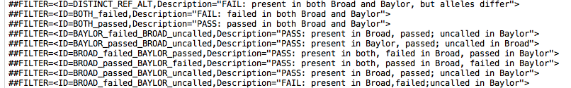
Variants by ADSP consortium

Slide 4
Variants by ADSP consortium
ALL: 1,586,687; PASS: 1,431,108; MAF: 49,235
PASS/ALL: 90.2%; MAF/PASS: 3.4%

Slide 5
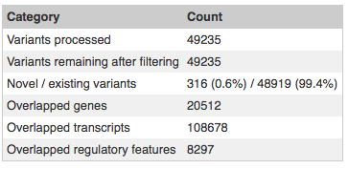
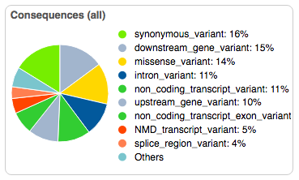
Variants by ADSP consortium

Slide 6
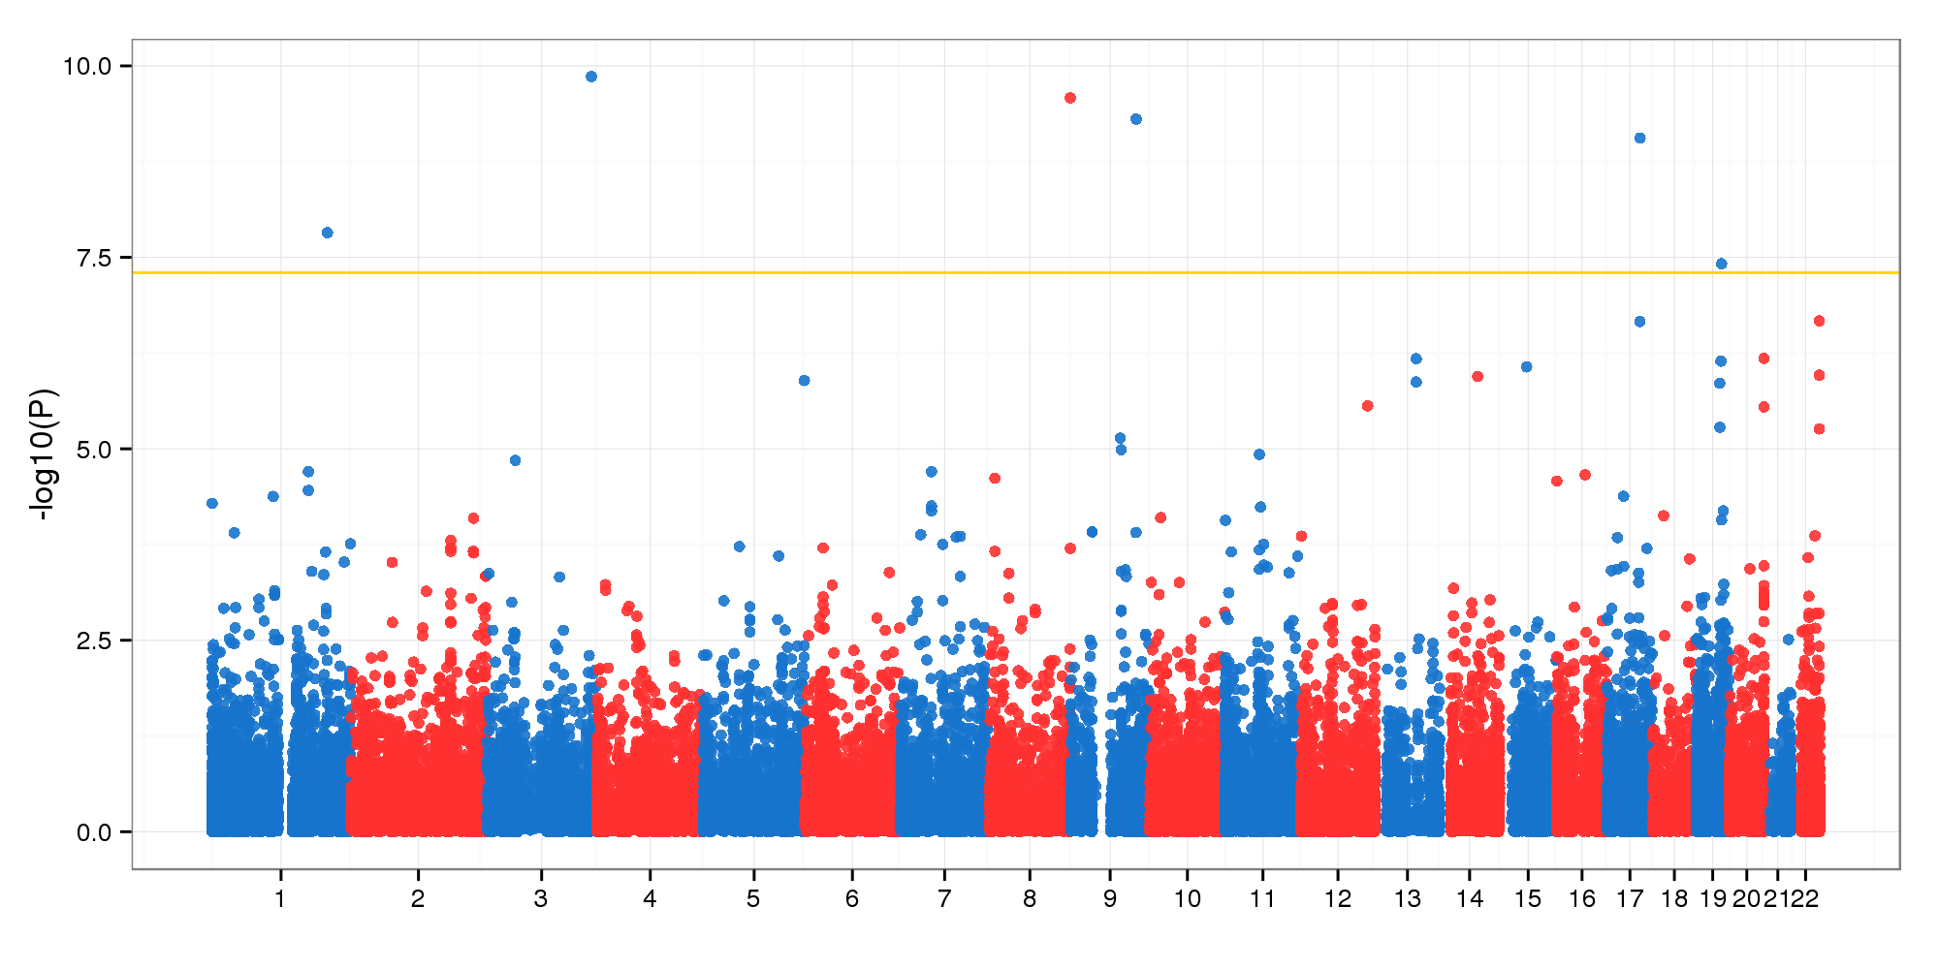
GWAS with all samples
Method: GLMM in GMMAT with covariates: Age, Sex
Chen et al., AJHG 2016 used penalized quasi-likelihood method as proposed by Breslow and Clayton 1993
22 above 5

Slide 7
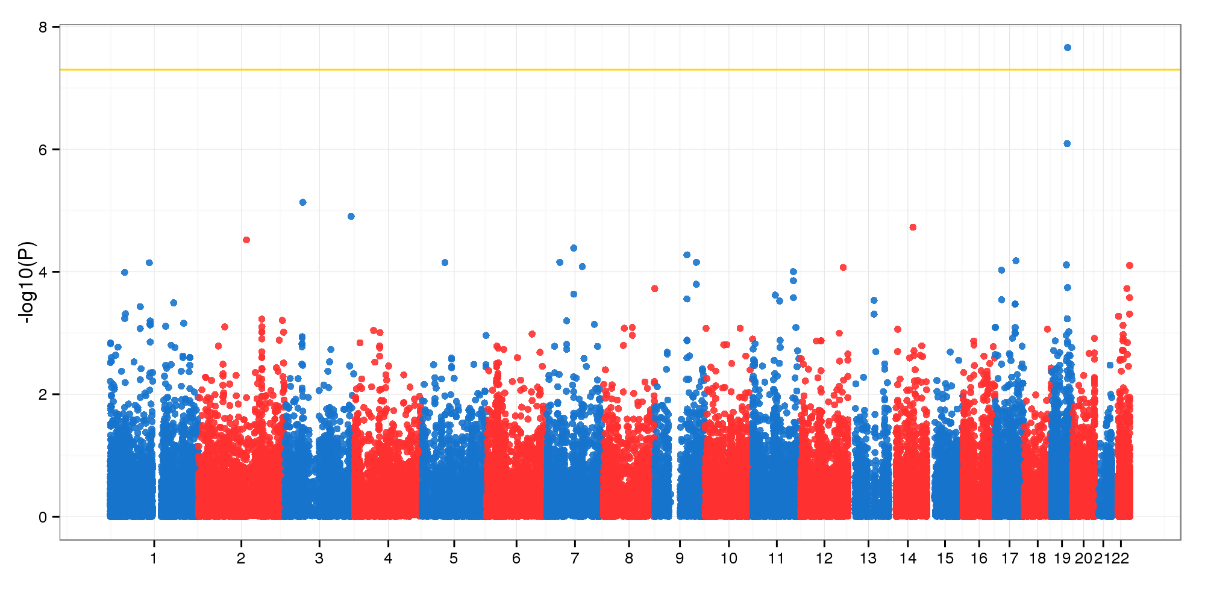
GWAS with all samples
Method: GLMM in GMMAT with covariates: Age, Sex, PC1

Slide 8
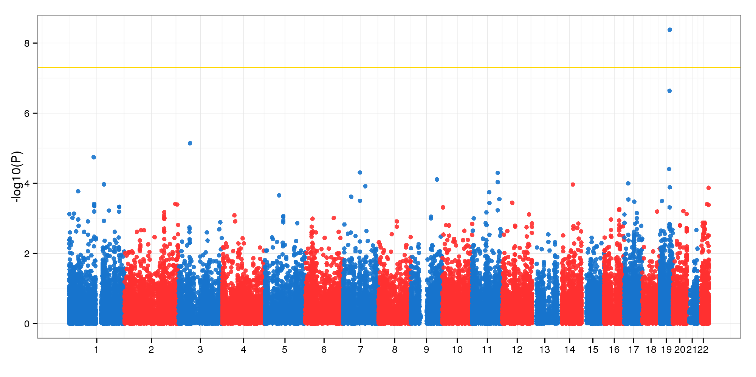
GWAS with all samples
Method: GLMM in GMMAT with covariates: Age, Sex, PC1, PC2

Slide 9
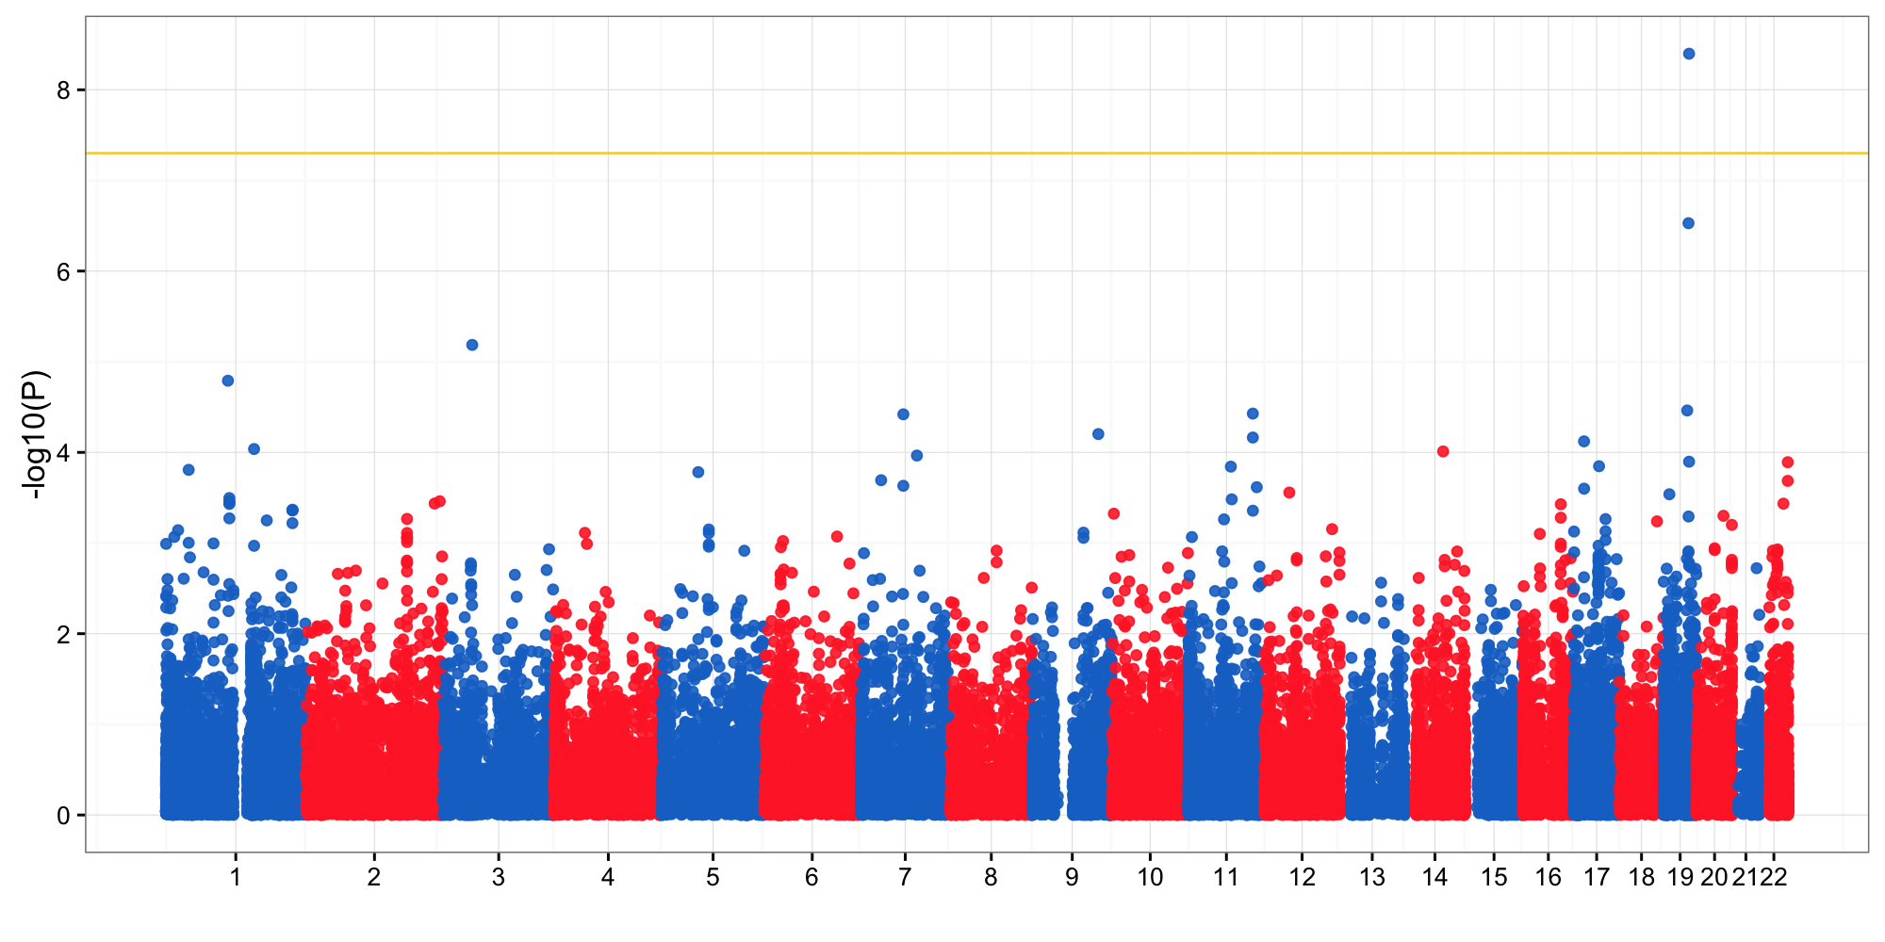
GWAS with all samples
Method: Logistic regression in Plink with covariates: Age, Sex, PC1, PC2
PC were sufficient to correct the population stratifications.
PC corrected more, some latent factors.

Slide 10
9 variants in 7 loci (P < 1e-4)
APOE
ABHD14A
SLC6A17
NXPE1
CEACAM21
UPK3B
KIF12

Slide 11
APOE locus

Slide 12
400 Kb away from APOE locus

Slide 13
67 variants in 45 loci (P < 1e-3)
58 of the 67 had IGAP results, correlations were poor
A table of the 67 variants available at the ADSP shared folder (./Xulong/04May2016)

Slide 14
Variants by ADSP consortium: WGS also showed center-specific effects?

Slide 15
Variants by ADSP consortium
ALL: 27.9 million; PASS: 25.5 million; MAF: 10.3 million
ADSP released VCF for 578 out of 584 samples, 570 out of the 578 had disease status

Slide 16
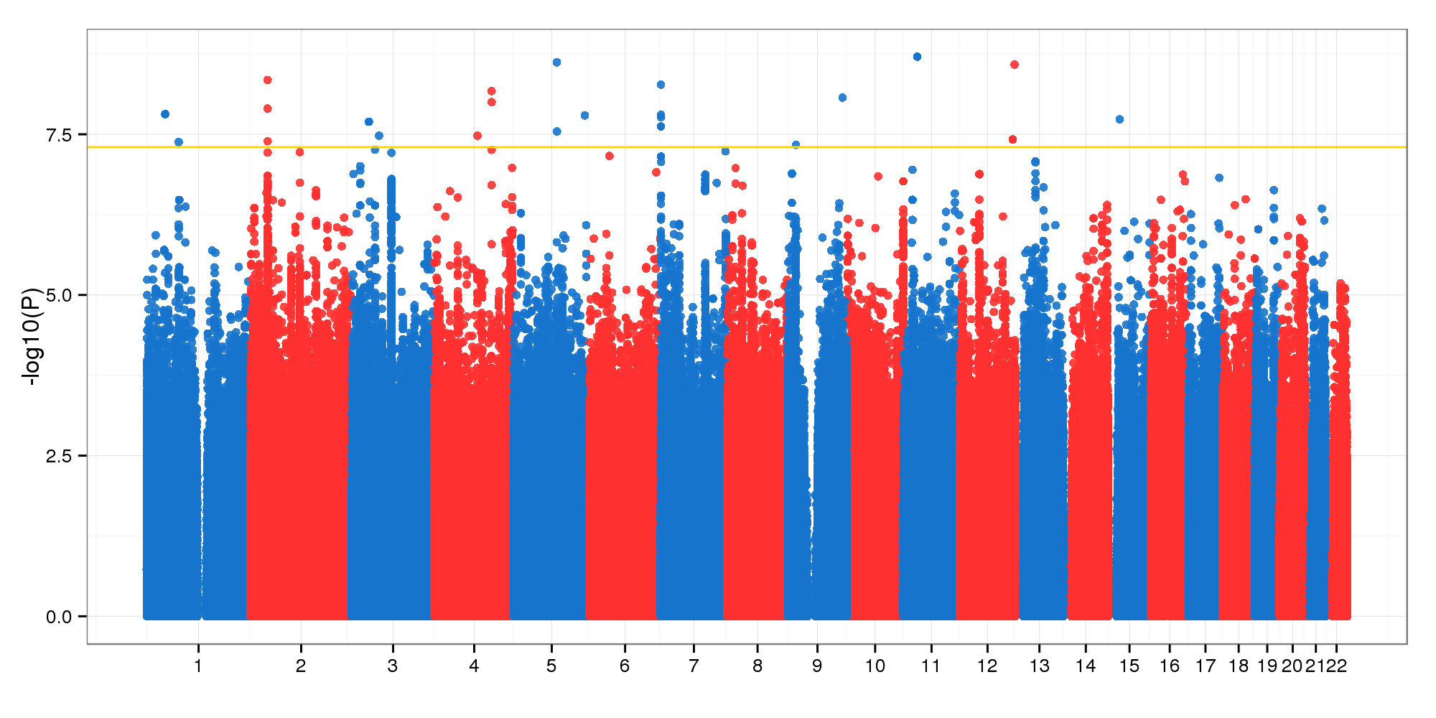
GWAS of ADSP WGS using ADSP’s variants
Method: BAYES.GLMM without kinship correction
Covariates: Age, Sex

Slide 17
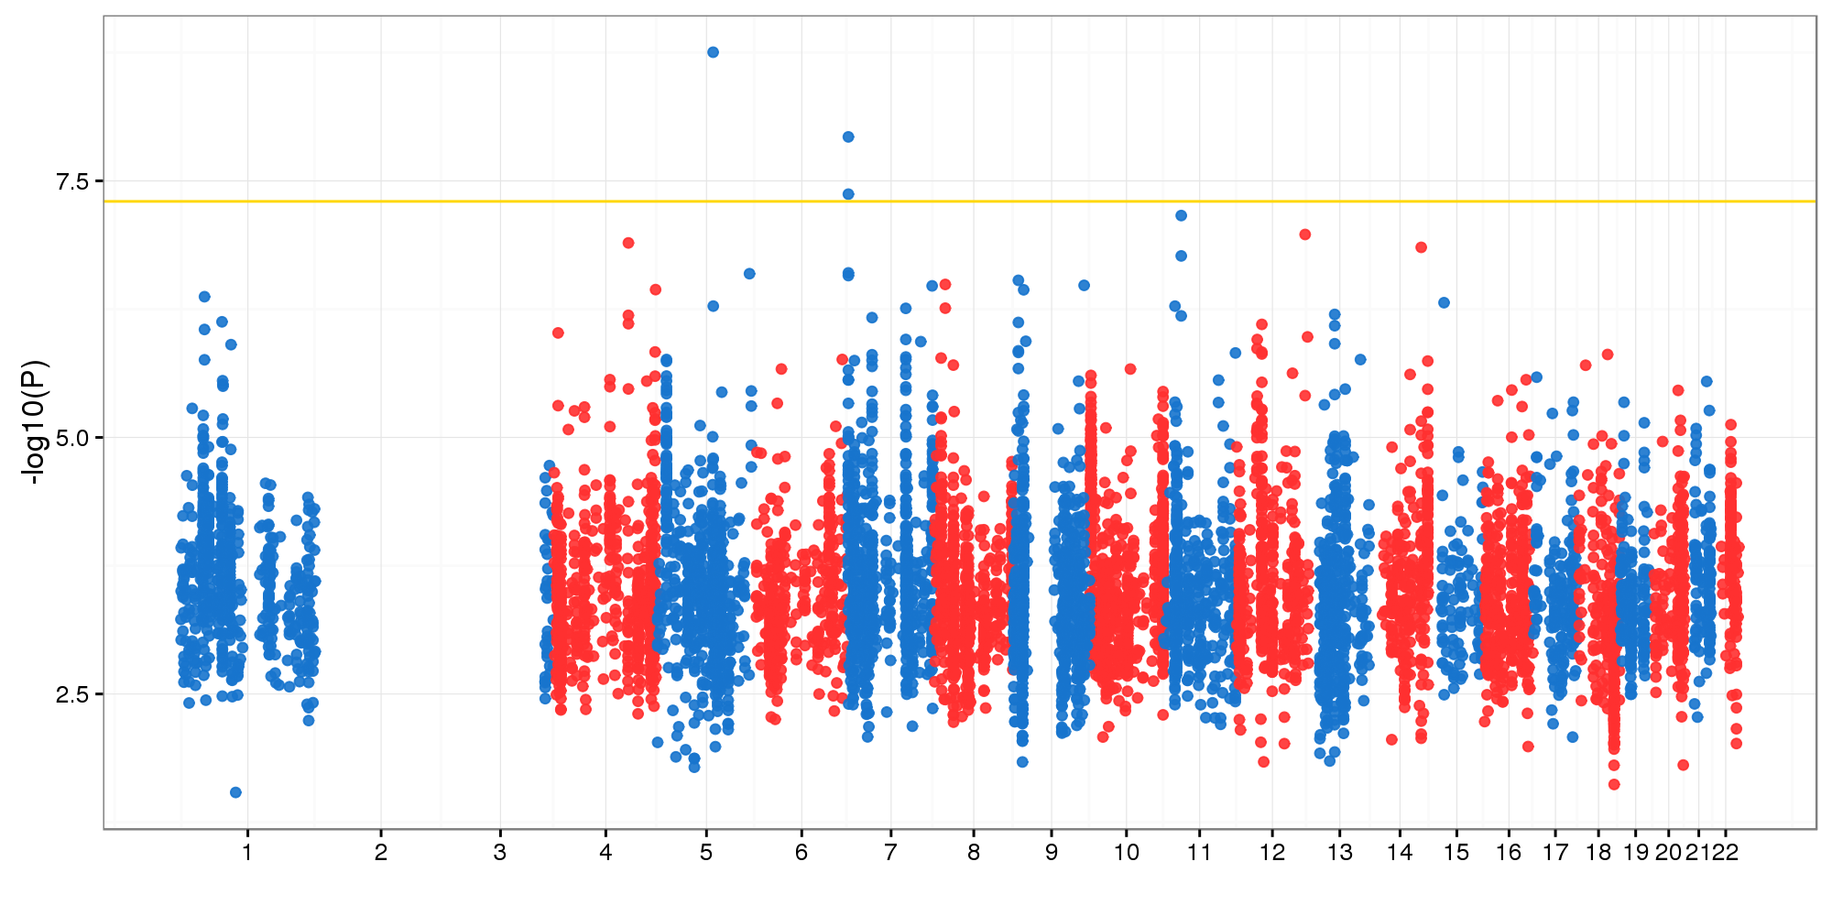
GWAS of ADSP WGS using CS’s variants
Method: BAYES.GLMM with kinship correction
Covariates: Age, Sex

Slide 18
3 significant variants in 2 loci, all intergenic
MAF 0.02 (5:102726073_C/T) and 0.05 (7:580540_A/G, 7:580735_C/A)

Slide 19
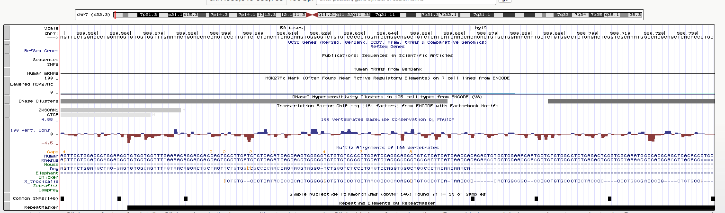
chr7:580540 and chr7:580735

Slide 20
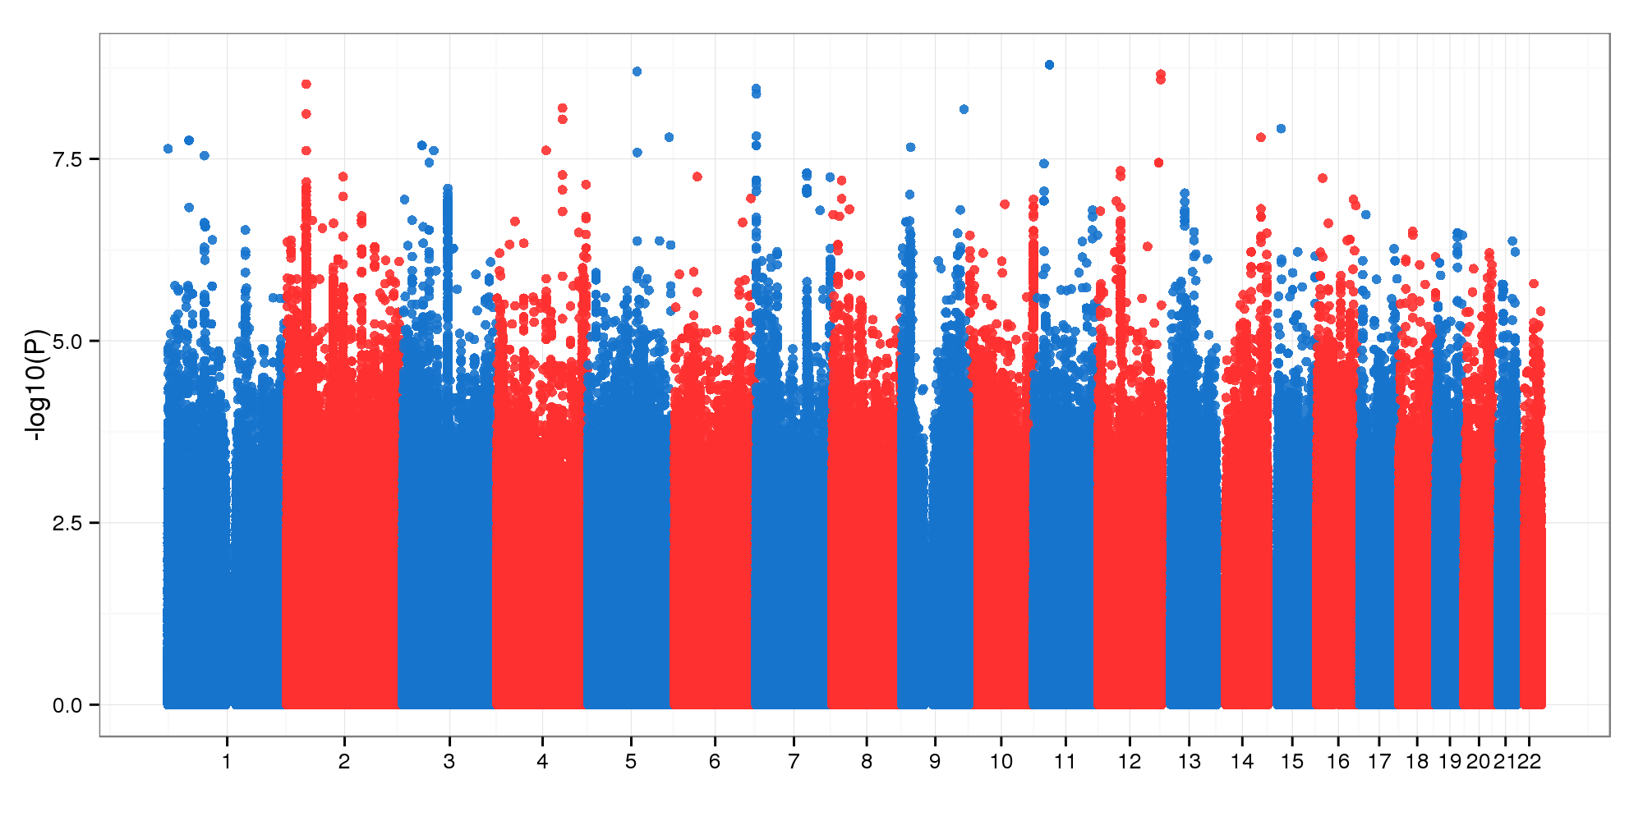
GWAS of ADSP WGS using CS’s variants
Method: BAYES.GLMM without kinship correction
Covariates: Age, Sex

Slide 21
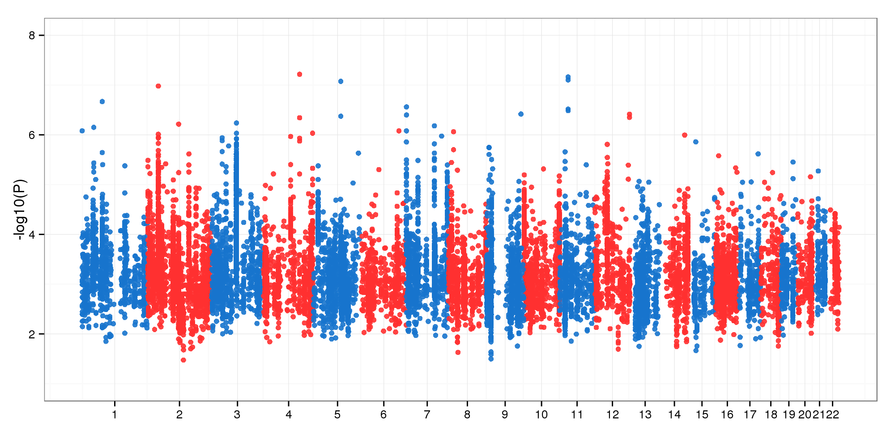
GWAS of ADSP WGS using ADSP’s variants
Method: BAYES.GLMM with kinship correction
Covariates: Age, Sex
570 vs 576 samples
Kinship matrices were different

Slide 22
GWAS with all samples
Method: GLMM in GMMAT with covariates: Age, Sex
Chen et al., AJHG 2016 used penalized quasi-likelihood method as proposed by Breslow and Clayton 1993
22 above 5

Slide 23
PCA on the 49,235 variants and 9949 samples

Slide 24
PCA on the 49,235 variants and 9949 samples

Slide 25
PCA on the 49,235 variants and 9949 samples

Slide 26
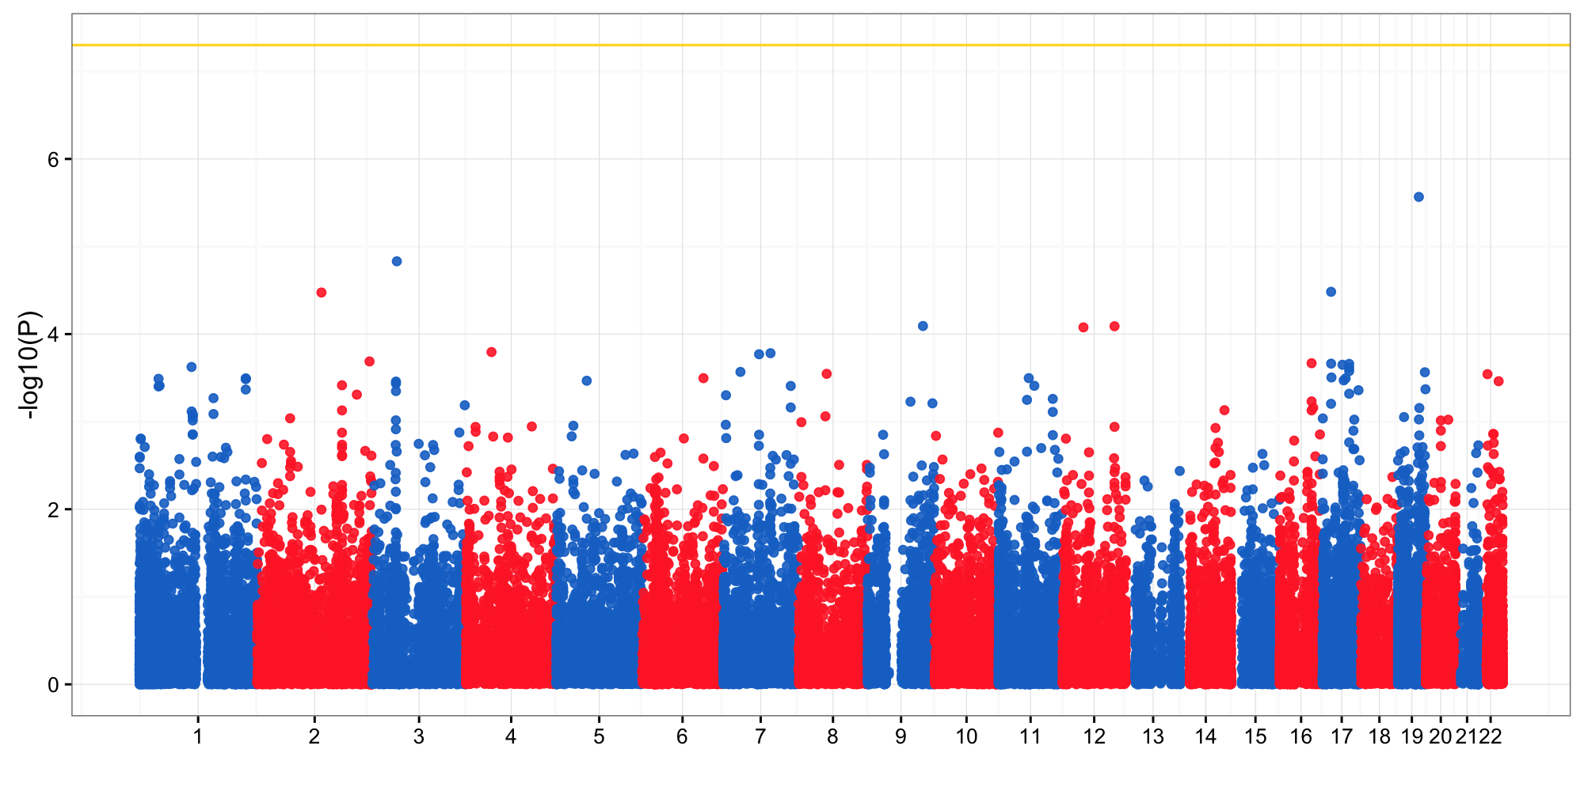
GWAS without the “enriched” samples
Method: Logistic regression in Plink with covariates: Age, sex

Slide 27
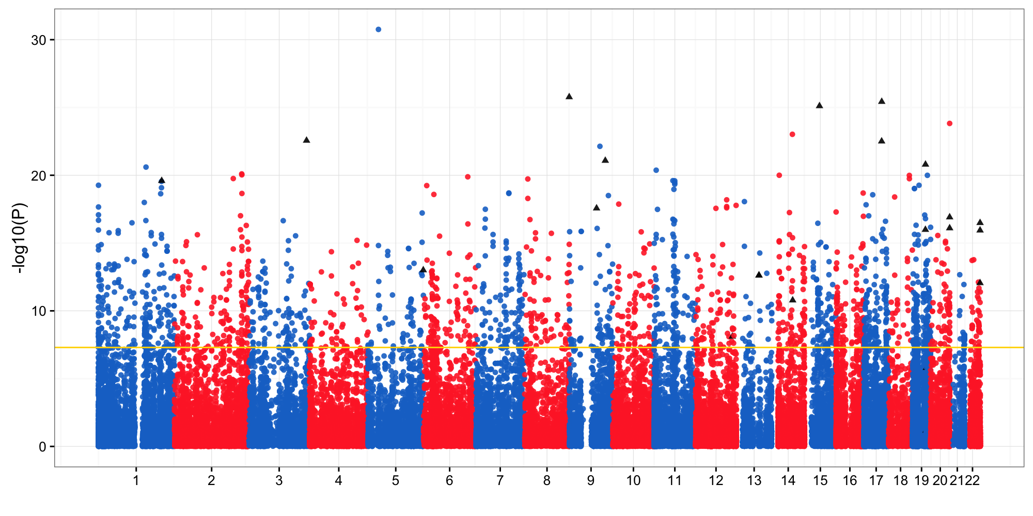
GWAS with only the “enriched” samples
Method: Logistic regression in Plink with covariates: Age, sex

Slide 28
To do
Functional annotations of top variants
WGS: GLMM by BAYES.GLMM in established pipeline (21/22 done)

Slide 29
ADSP WES data: 9949 samples by 3 sequencing centers
10 of the 9949 samples were sequenced independently by the 3 centers. This led to 20 redundant sequencing results, which were removed.
The 9949 samples were each diagnosed as case or control in Alzheimer’s disease status.
The 9949 samples came from two groups: case control, and enriched. The 816 enriched samples had 645 case and 171 controls.

Slide 30
5484 cases and 4465 controls, 4254 male and 5695 females
10% more case than control, and 14% more female than male

Slide 31
Anyone older than 90 were annotated as “90+”
1307 people and 13.1% of the total were annotated as “90+”.
We viewed these people as 90 years old in the association analysis.

Slide 32
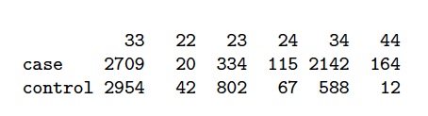
APOE genotypes
We had 6 unique APOE genotypes, which constitute all the possible bi-allelic combinations of 3 APOE allele types.
Homozygous e3 was predominantly the majority, while homozygous e2 and e4 were rare.
Homozygous e4 carriers showed a 15-fold increased risk for developing AD comparing to the homozygous e3 carriers

Slide 33
PCA on the 49,235 variants and 9949 samples

Slide 34
PCA on the 49,235 variants and 9949 samples

Slide 35
PCA on the 49,235 variants and 9949 samples

Slide 36
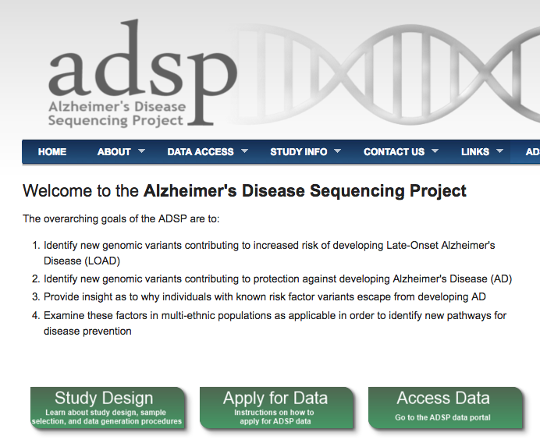

Slide 37
Variants and association analysis
Variants were filtered out by 3 criteria, below, which left 30959 variants
outside of the shared probe regions,
carried a non-"PASS" flag in any sample,
MAF threshold 0.01. 30959 variants were kept for the association analysis.

Slide 38
PCA on the 30959 variants and 9949 samples

Slide 39
PCA on the 30959 variants and 9949 samples

Slide 40
PCA on the 30959 variants and 9949 samples
No more sequencing center-specific effects

Slide 41
PCA on the 30959 variants and 9949 samples
Enriched samples were different from the others in genotypes

Slide 42
PCA on the 30959 variants and 9949 samples
Enriched samples were different from the others in genotypes

Slide 43
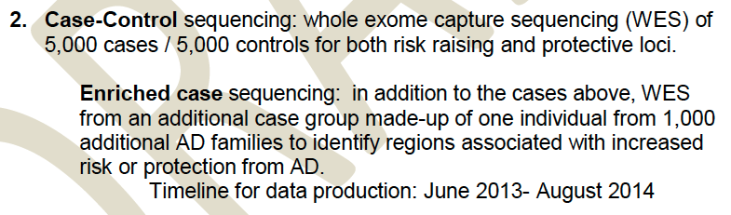
Enriched case

Slide 44
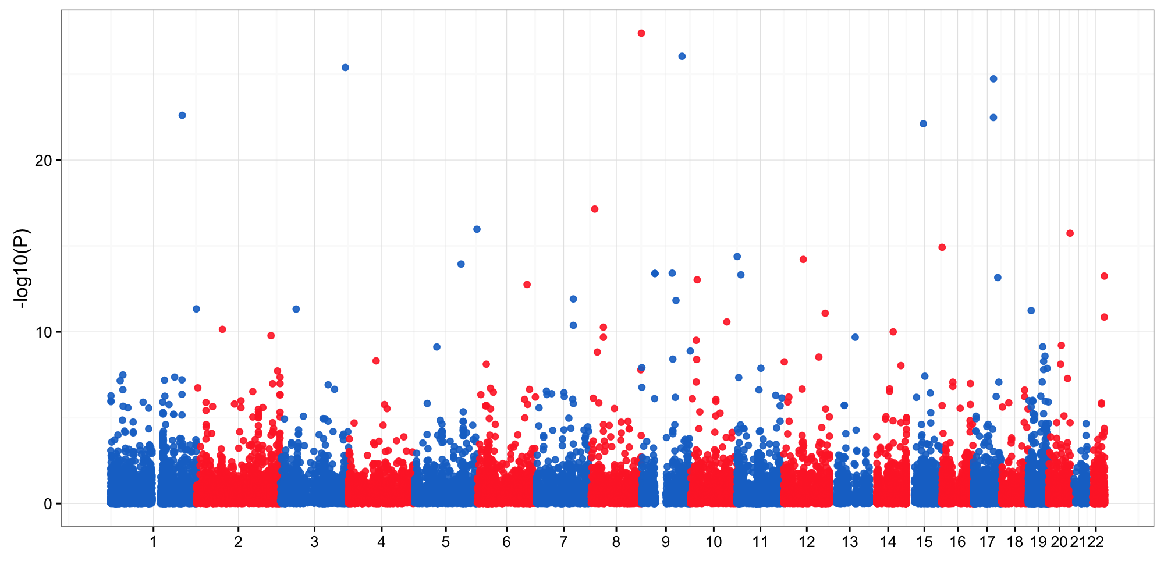
Manhattan with all samples

Slide 45
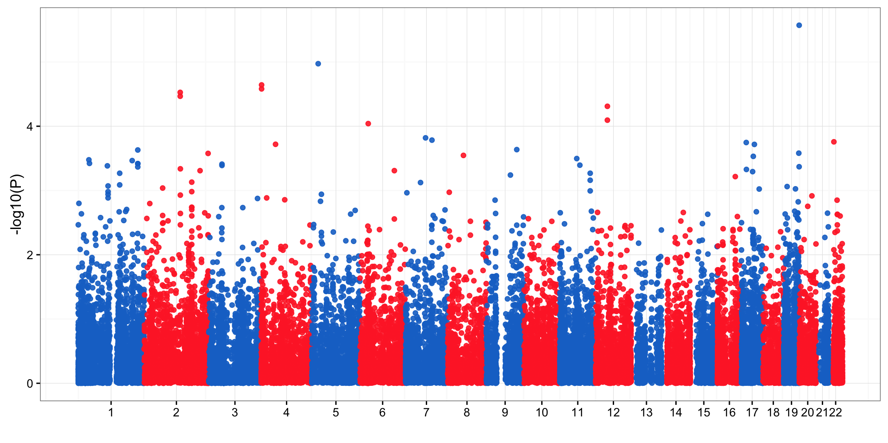
Manhattan without the “enriched” samples
APOE SNP: rs7412 and rs429358, were all flagged as “LowQual” and “LowCoverage”

Slide 46
Variants with small proportions of non-”PASS” flag ought to be tolerated
No chromosome: 1, 6, 11, 19
48091 variants MAF > 0.01
46139 of 48091 showed “PASS” in at least 80% of carriers

Slide 47
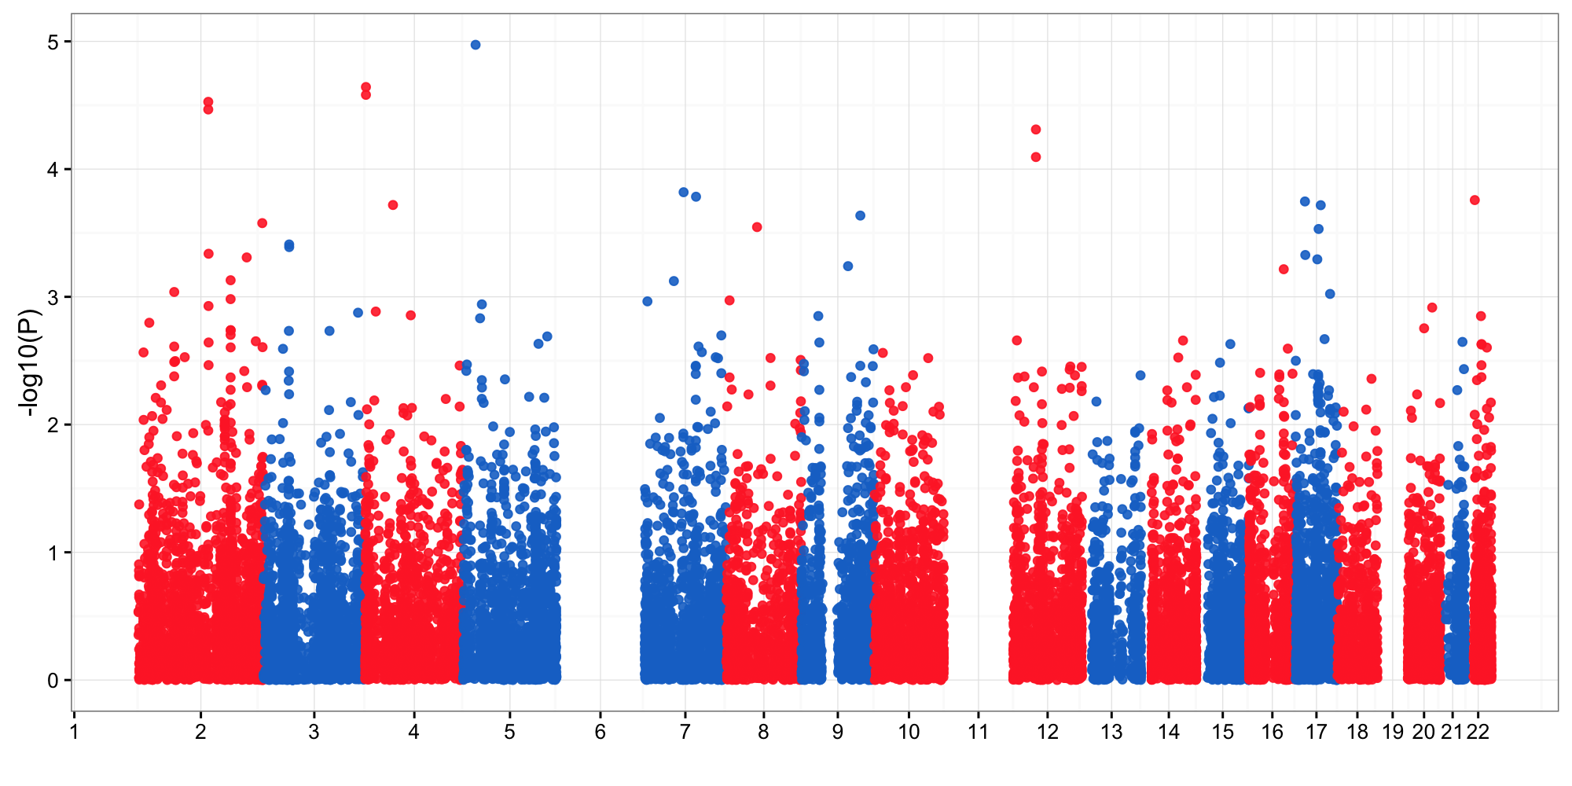
Manhattan with expanded variants

Slide 48
Genomic Variants by GATK

Slide 49
72447 SNP and IND with MAF 0.01 and morec

Slide 50
PCA on genotypes
Out of 72447, 9764 only called by Broad, and 3255 only called by Bayor/WashU

Slide 51
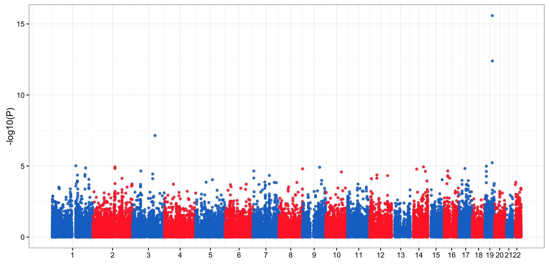
WES w/o priors
Logistic method in Plink with covariates: age, sex, PC1

Slide 52
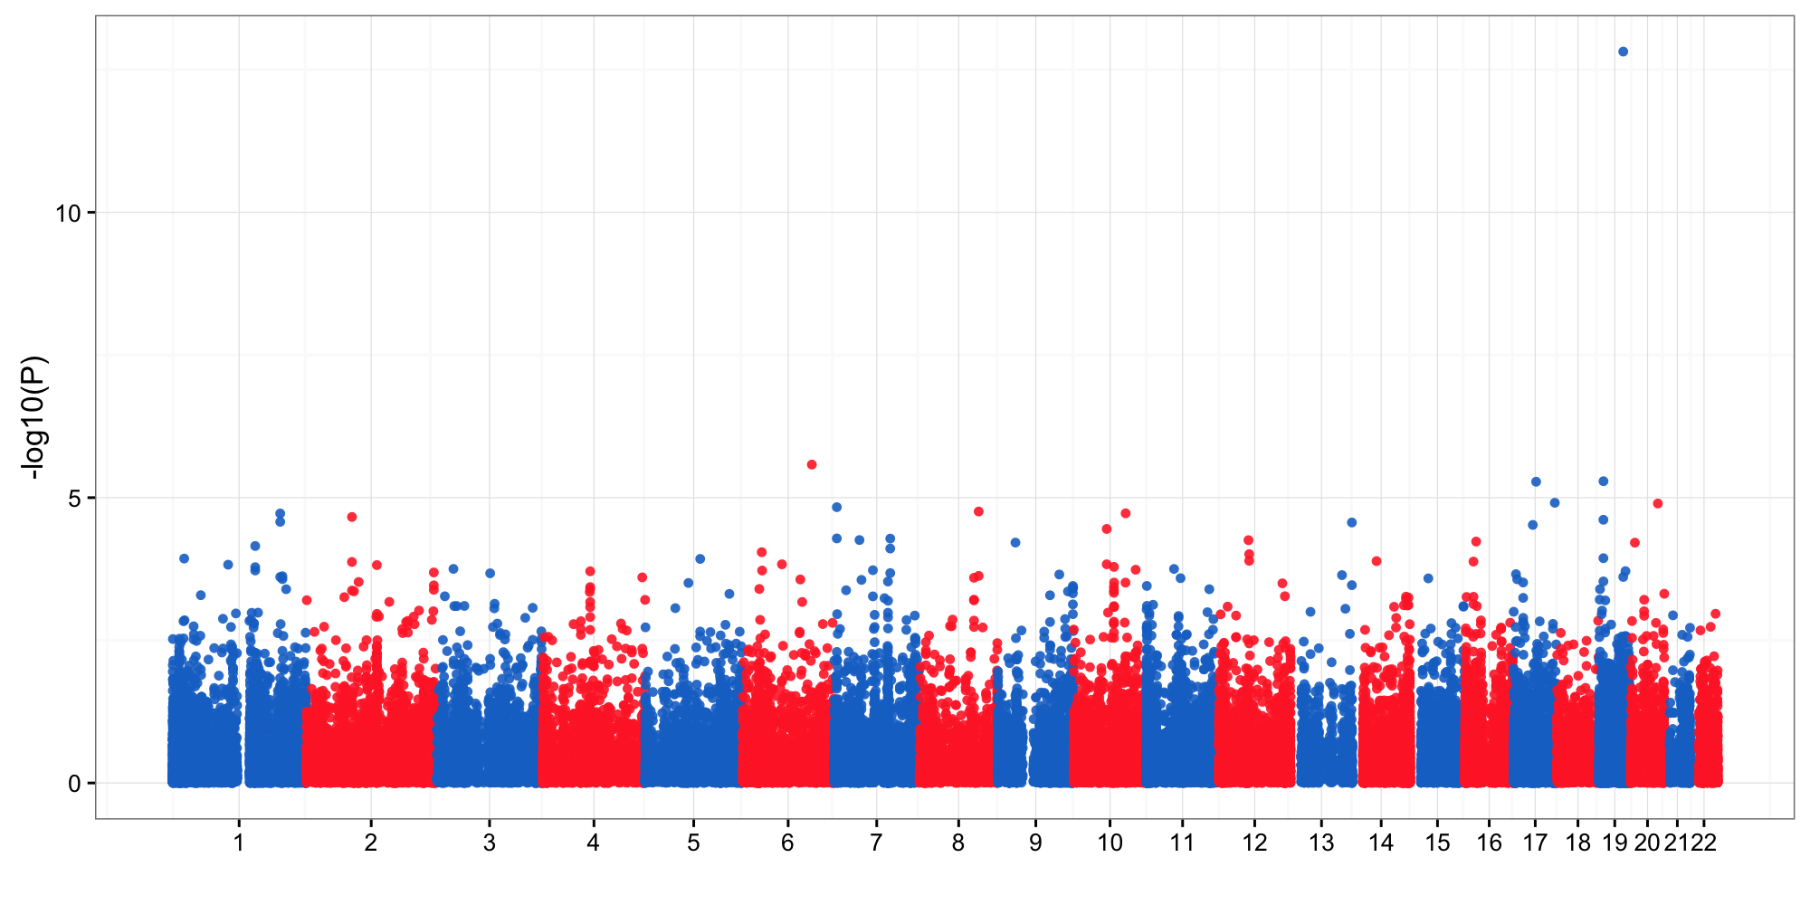
Broad only WES w/o priors
Logistic method in Plink with covariates: age, sex

Slide 53
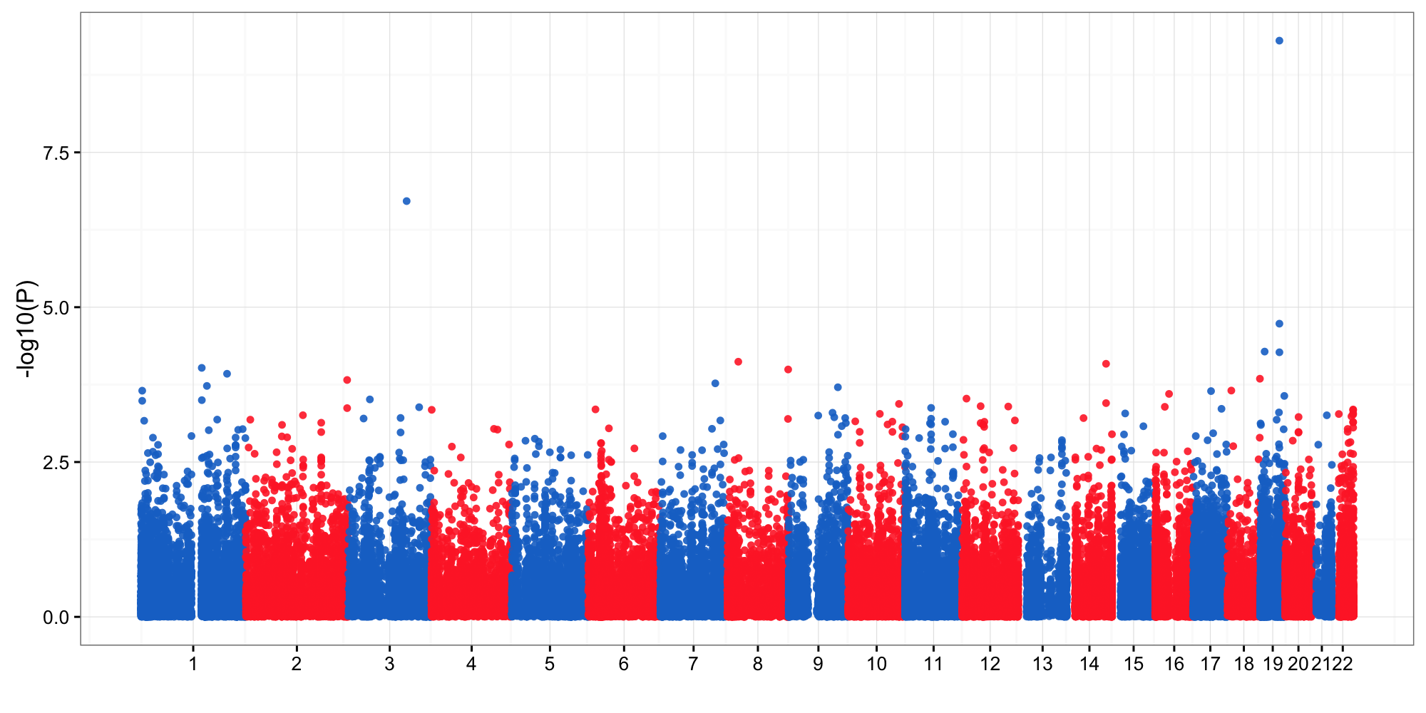
Bayor/WashU only WES w/o priors
Logistic method in Plink with covariates: age, sex

Slide 54
Generalized linear mixed model in Bayesian framework (bayes-glmm)
Ordered logistic model
Random term by Cholesky factoring
Priors
AD status was modeled by an ordered categorical variable
Population structure was modeled by a random term that followed a multivariate normal distribution with covariance matrix constrained by the IBS kinship relatedness
Prior knowledge can be included as a standardized effect size
Kinship computed by Plink; model implemented in Stan (http://mc-stan.org/)

Slide 55
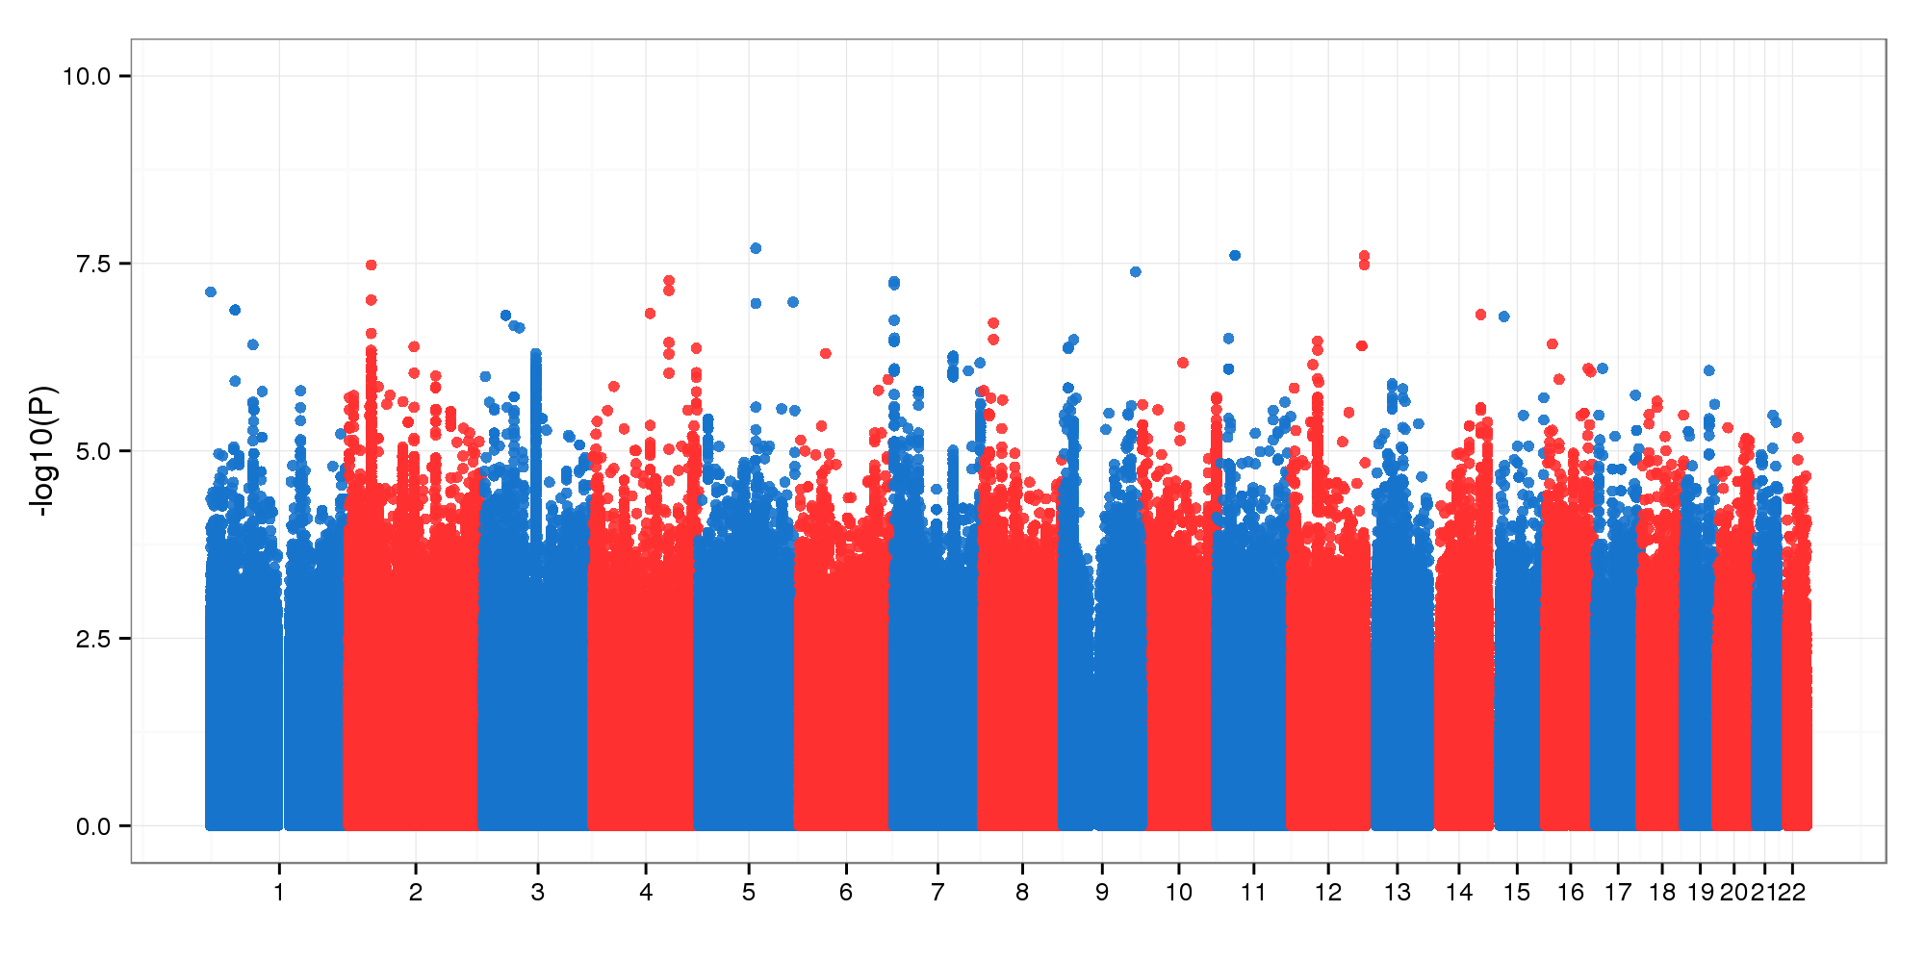
WGS w/o priors
This results ought to be replaced by the MCMC sampling estimations.
GLMM method with covariates: age, sex

Slide 56
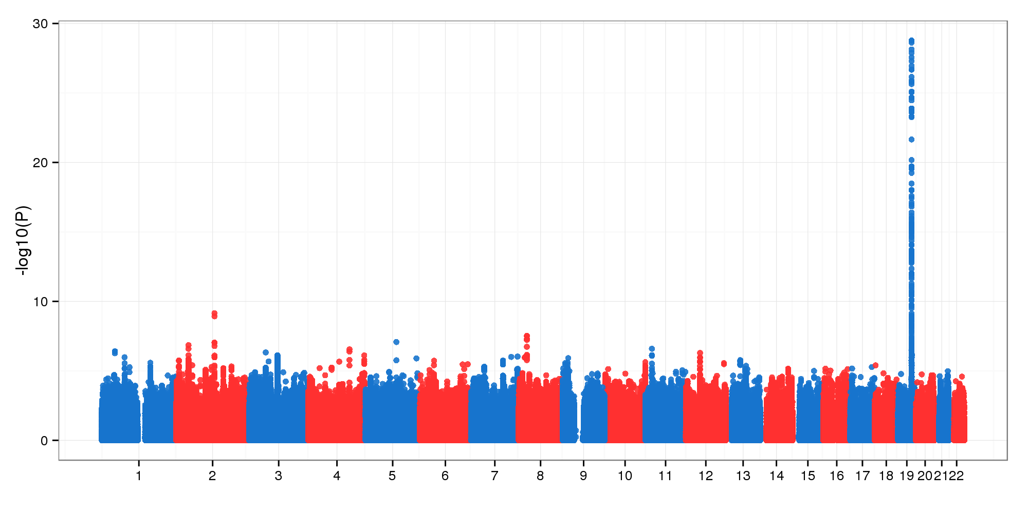
WGS with priors
This results ought to be replaced by the MCMC sampling estimations.
GLMM method with covariates: age, sex
APOE, BIN1, CLU loci genome-wide significant

